Slide 1

Emerging Technologies
Session #04.0: The virtual machine
IBM Bluemix
The Digital Innovation Platform
Sylvain-Roch WILBERT
s_wilbert@fr.ibm.com
Université Paris - Dauphine

Slide 2
The virtual machine
An Ubuntu virtual machine is proposed in order to run the workshops.
=> All software are included and setup
Prerequisites
10Gb on your hard disk to host the virtual machine
Virtual Box is to be installed (https://www.virtualbox.org)
Allow at least 2 GB Ram and 1 CPU

Slide 3
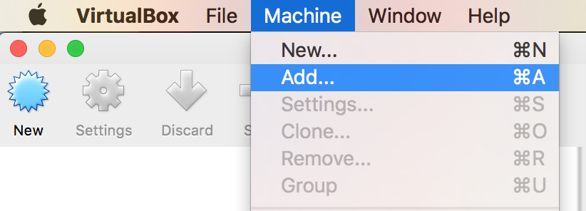
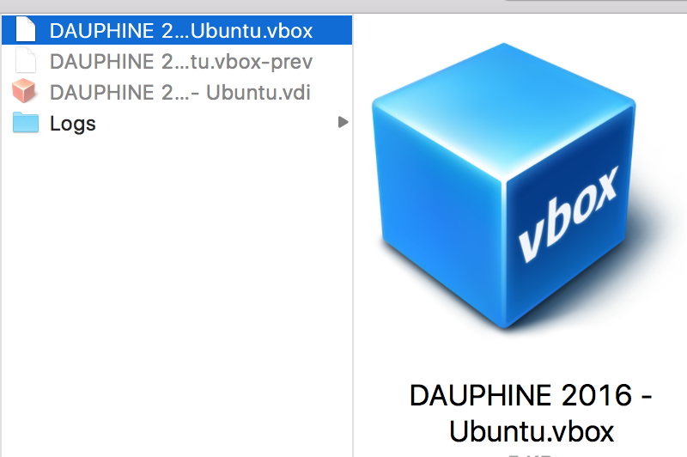
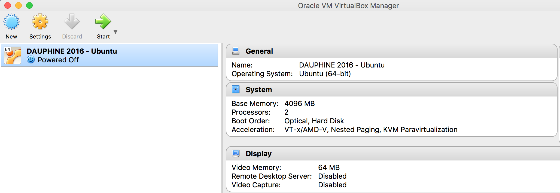
Running the Virtual Machine
Pre requisites:
VirtualBox shall be installed on your laptop
The Virtual machine “DAUPHINE 2016 – Ubuntu” folder shall be copied to your hardrive
Steps:
In VirtualBox : Machines > Add
Open the .vboxfile
You can launch your virtual machine

Slide 4
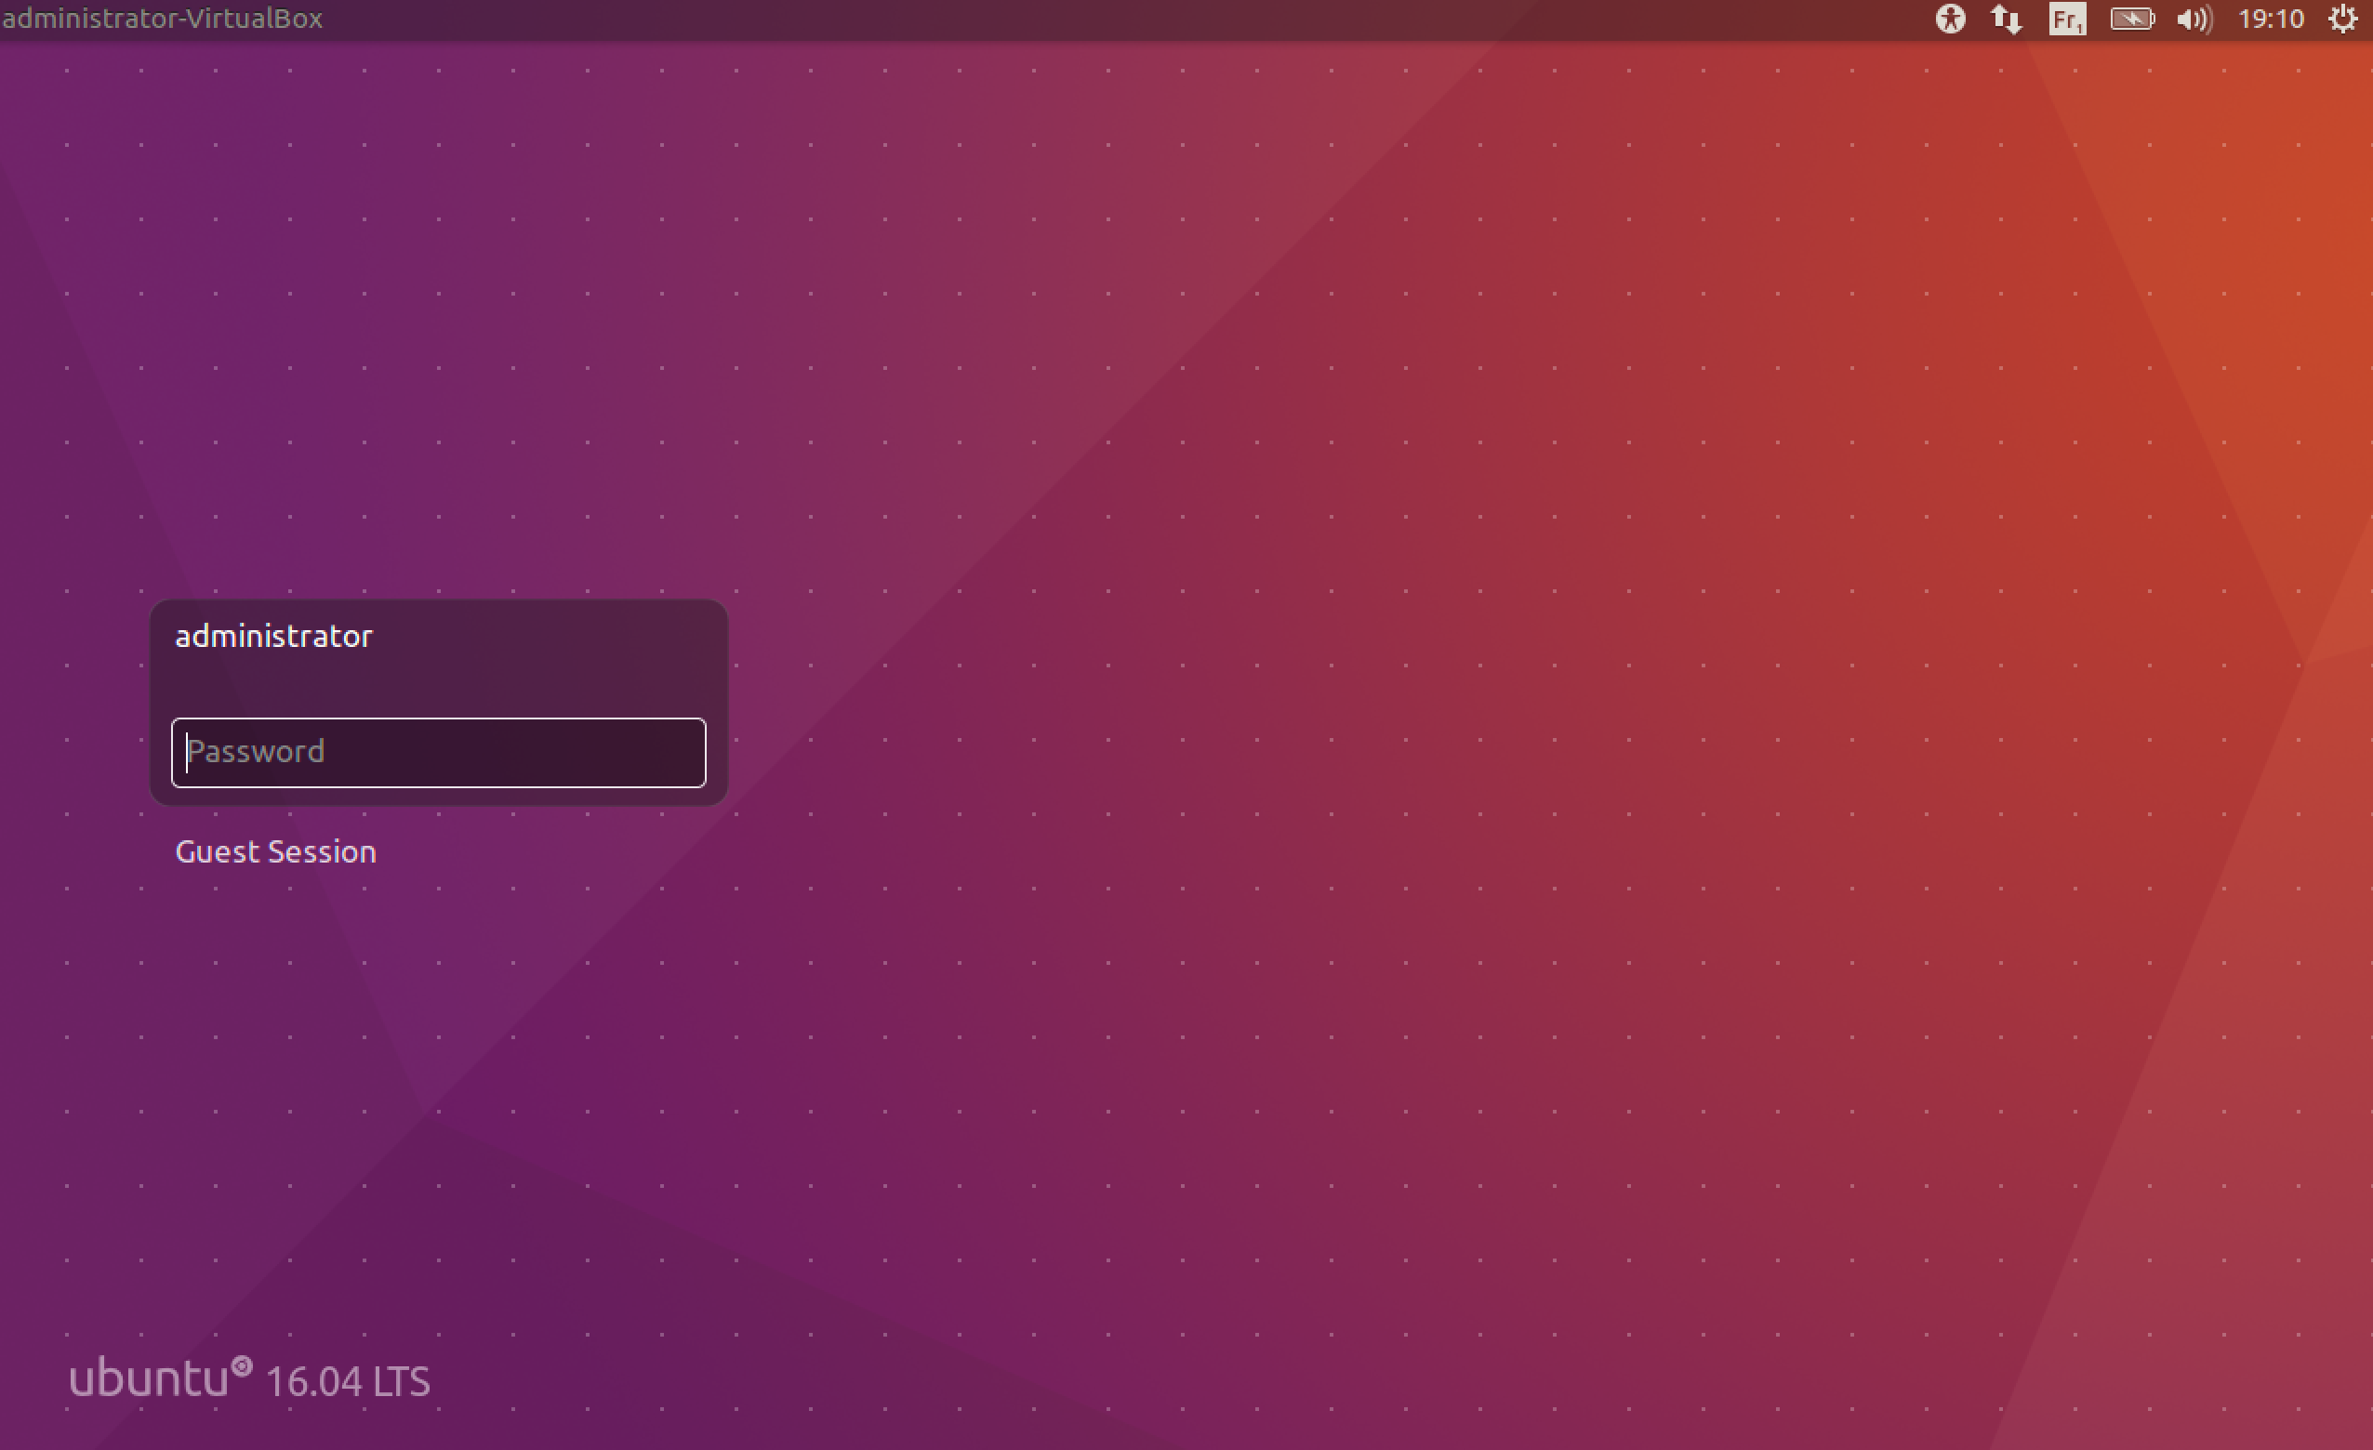
Load the virtual image provided using VirtualBox
administrator (password)

Slide 5
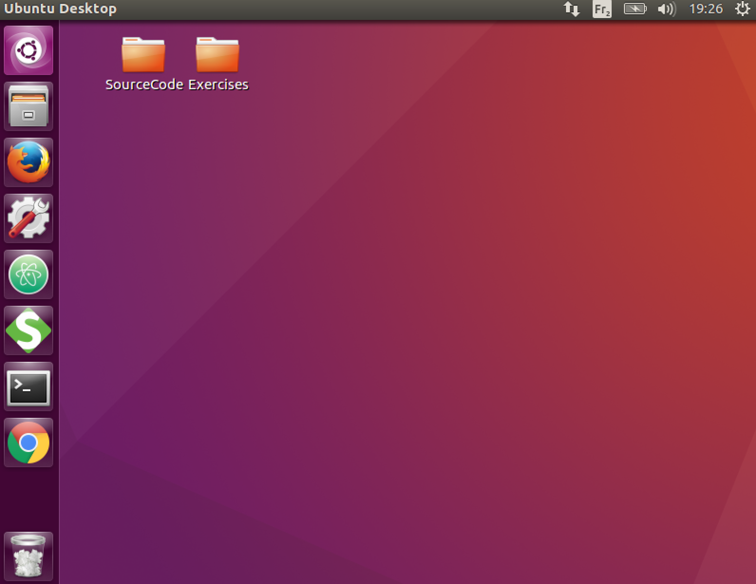
The tools
Source code
Workspace
Firefox web browser∑
ATOM IDE
SOAPUI – API Client
Terminal
Google Chrome

Slide 6
Some useful commands
ls List the content of a directory
cd Change Directory
ps –ef|grep node List all running processes called node (including ProcessID)
kill -9 PID Terminate the Process ID
sudo command Run command as root
ifconfig Show network information
More commands: Linux Cheat Sheet on Google …

Slide 7
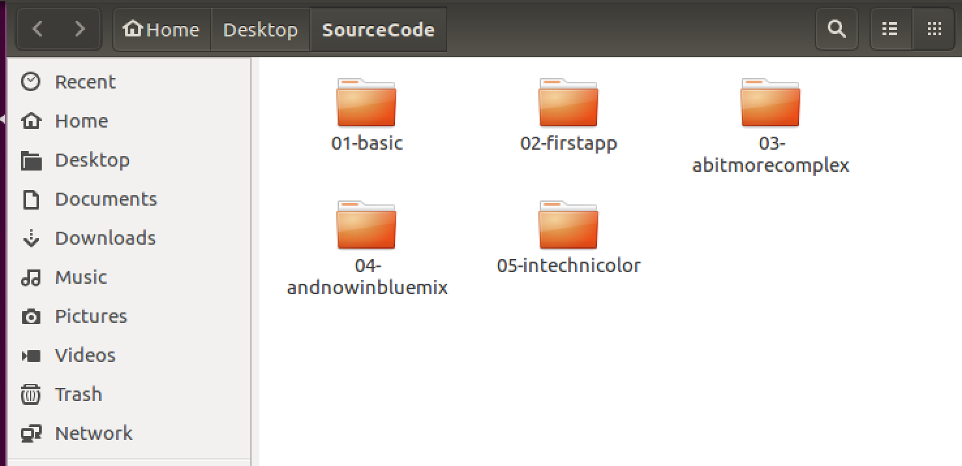
The source code
Shall be retrieved from the box.com (see previous URL)
and placed in the SourceCode Folder

Slide 8

Alternative
The following software are used during the session and shall be installed
a Text Editor : Atom: https://atom.io
nodeJS : https://nodejs.org/en/
CloudFoundry Command Line Interface: https://github.com/cloudfoundry/cli/releases
Git :
Rest API injection : SOAP UI : https://www.soapui.org/

